Slide 1
Task Management System
A Comprehensive Overview of Our Project on AWS
Team name:
Cloud_AWS_TEAM_101
Team Members:
Ali Amr ID - 10000652
Mostafa Abuzahra - 10001994
Mohamed gad - 10001181
Mamdouh Mahfouz - 10001816
Adham Hisham - 10000480
Mohammed Emad - 10006645
Mohammed Tarek - 10002243

Slide 2
Project Overview
Content:
Objective:
  Design and implement a fully functional Task Management System leveraging AWS services to provide secure authentication, task management, notifications, and real-time monitoring.
Technologies Used:
  Backend: AWS CDK (Python) for infrastructure, Lambda, API Gateway, DynamoDB, S3, RDS, Cognito, CloudWatch, and SQS.
  Frontend: Next.js (React) with TypeScript for modern and responsive UI.
  Monitoring: AWS CloudWatch for performance monitoring, error tracking, and log management.
Key Features:
  User Authentication via AWS Cognito.
  Task Management: Create, Update, Delete, View tasks.
  File Attachments: Support for file uploads with AWS S3.
  Notifications: Task update notifications sent asynchronously via AWS SQS.
  Real-time Monitoring: CloudWatch integration for monitoring and alerting.

Slide 3
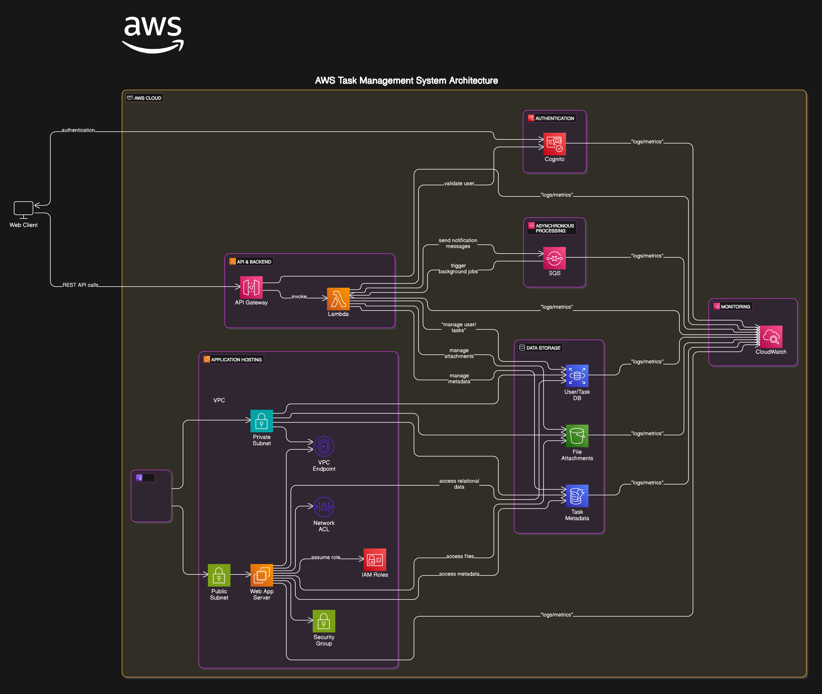

Slide 4
System Architecture:
Show the AWS Architecture Diagram (uploaded earlier) here.
Backend Services: Lambda functions triggered by API Gateway for task management operations, data stored in DynamoDB and RDS.
Frontend: Next.js interface connected to API Gateway.
User Authentication: AWS Cognito for login and sign-up management.
CloudWatch: Monitoring performance and logging of all backend services.

Slide 5
Design Decisions
Choice of AWS Services:
Serverless Architecture: Used AWS Lambda and API Gateway to minimize backend management and ensure scalability.
Data Storage:
  RDS for relational data (task relationships, user profiles).
  DynamoDB for fast, non-relational access to task metadata.
File Storage: S3 for secure file storage with attachments for tasks.
User Authentication: Integrated Cognito for secure user login and management.
Monitoring: Utilized CloudWatch for real-time monitoring of the entire system.

Slide 6

Challenges Encountered
Service Integration: Connecting various AWS services like Lambda, API Gateway, SQS, and Cognito was complex but ensured a seamless flow.
IAM Configuration: Setting up the correct IAM roles and permissions for secure service interaction.
Error Handling: Handling errors across Lambda functions, API Gateway, and DynamoDB effectively to avoid service disruption.
Cost Management: Working within AWS's Free Tier, ensuring that the resource usage did not exceed the allocated budget.
Frontend-Backend Communication: Ensuring smooth communication between the frontend (Next.js) and backend services (Lambda via API Gateway).

Slide 7
Key Takeaways
Practical Experience with AWS CDK: The project provided hands-on experience with deploying infrastructure on AWS using the CDK.
Serverless Best Practices: Gained valuable insight into serverless computing, focusing on Lambda and API Gateway for backend services.
IAM and Security: Understanding the importance of securing AWS resources and managing access through IAM roles.
Frontend and Backend Integration: Learning to connect a modern frontend (Next.js) with serverless backend services (Lambda, API Gateway).

Slide 8

Future Improvements
Advanced Monitoring: Implement more advanced monitoring and alerting capabilities using CloudWatch for deeper insights.
Scalability: Introduce Auto Scaling for EC2 or AWS Fargate for running the web application in the future.
Optimized Cost Management: Explore AWS cost optimization techniques, particularly for S3 and Lambda function executions.
Analytics: Incorporate task analytics (task completion rates, user activity tracking) to improve decision-making.

Slide 9
User Guide
Sign-Up: New users can create an account via Cognito, providing email and password for authentication.
Task Creation:
Title, Description, Due Date, Priority, and File Attachment (via S3).
Tasks are stored in DynamoDB for fast access.
Task Management: Users can view, update, or delete tasks from the dashboard.
Notifications: Users receive notifications through SQS when task statuses are updated.

Slide 10
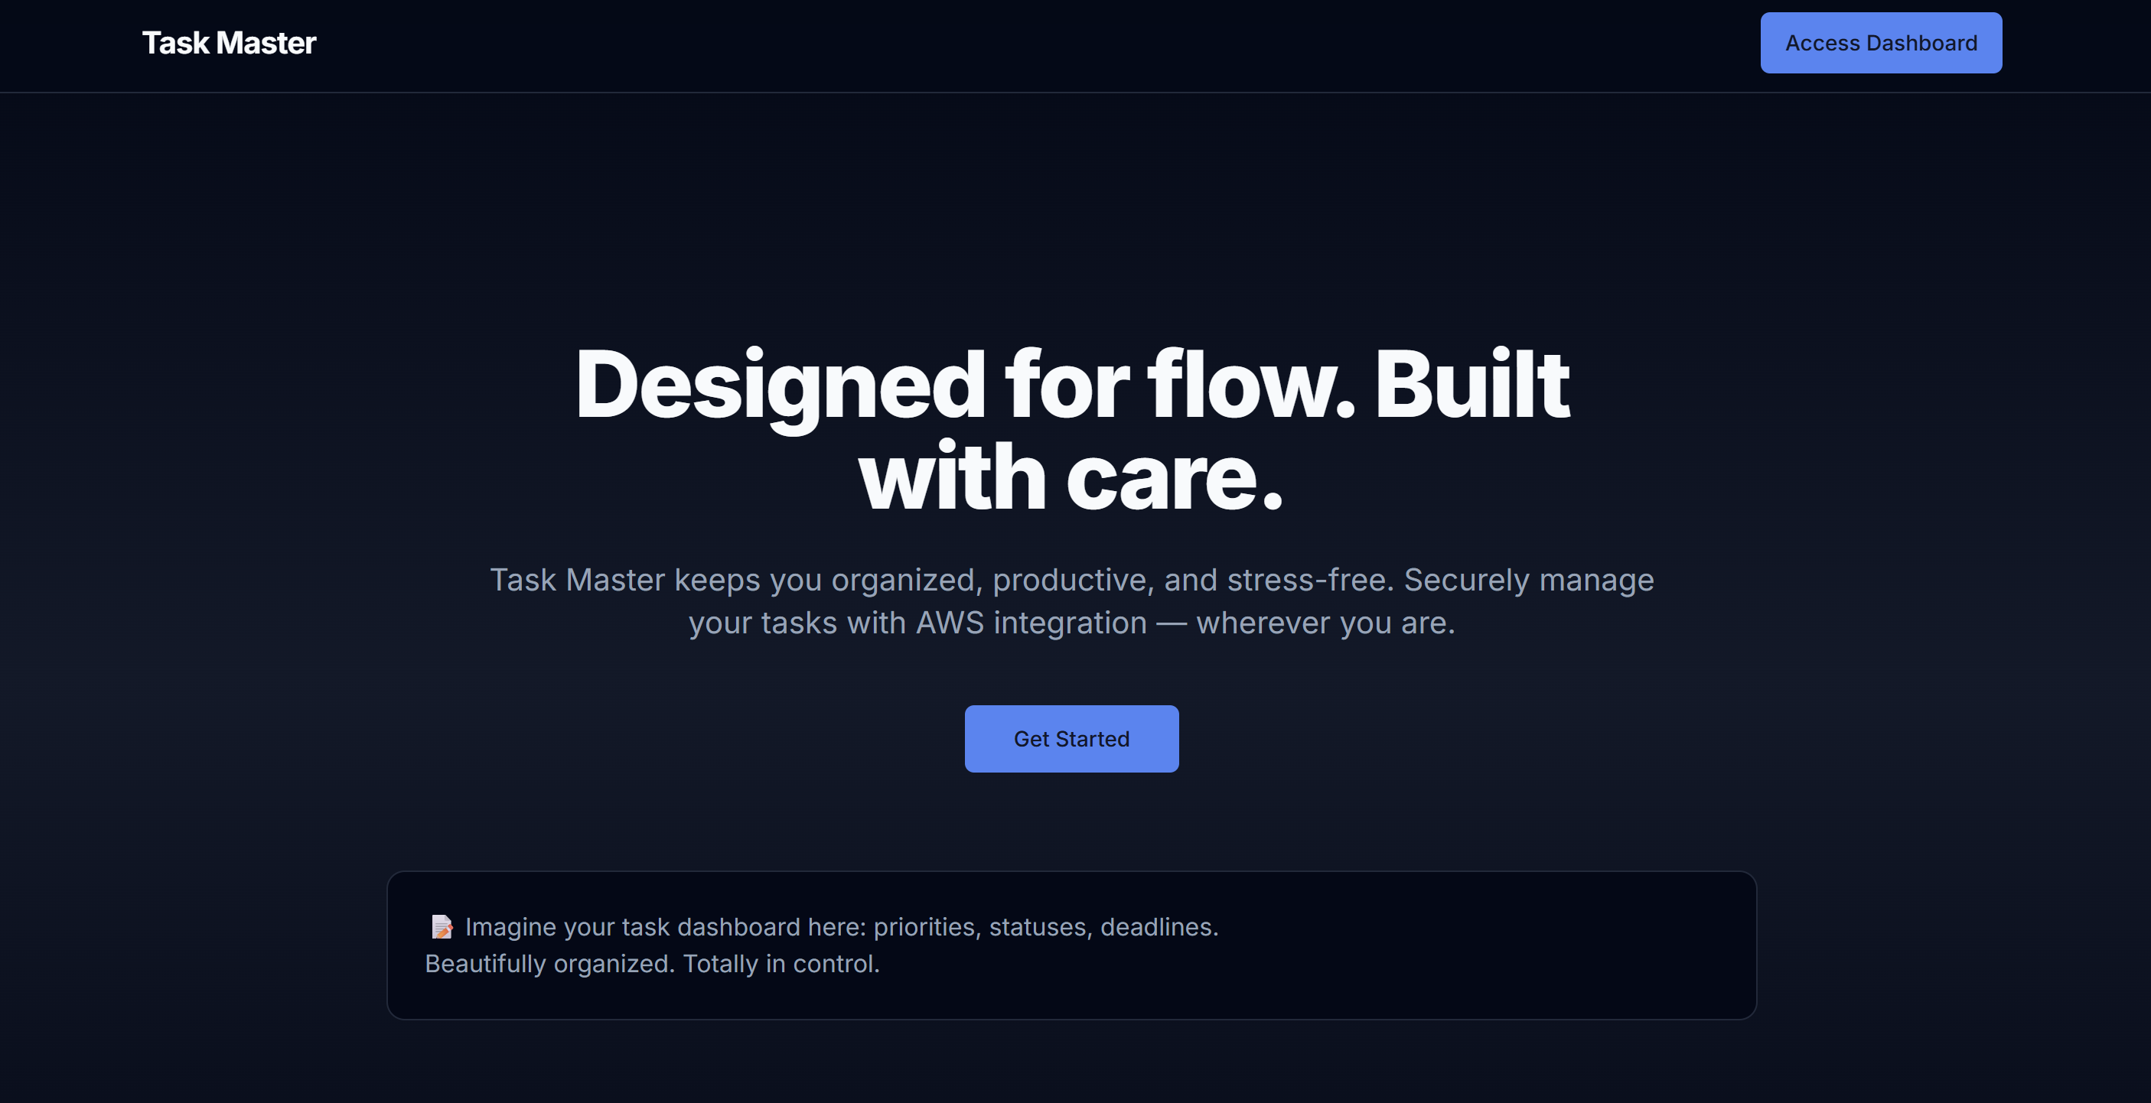
Demo / Screenshots

Slide 11
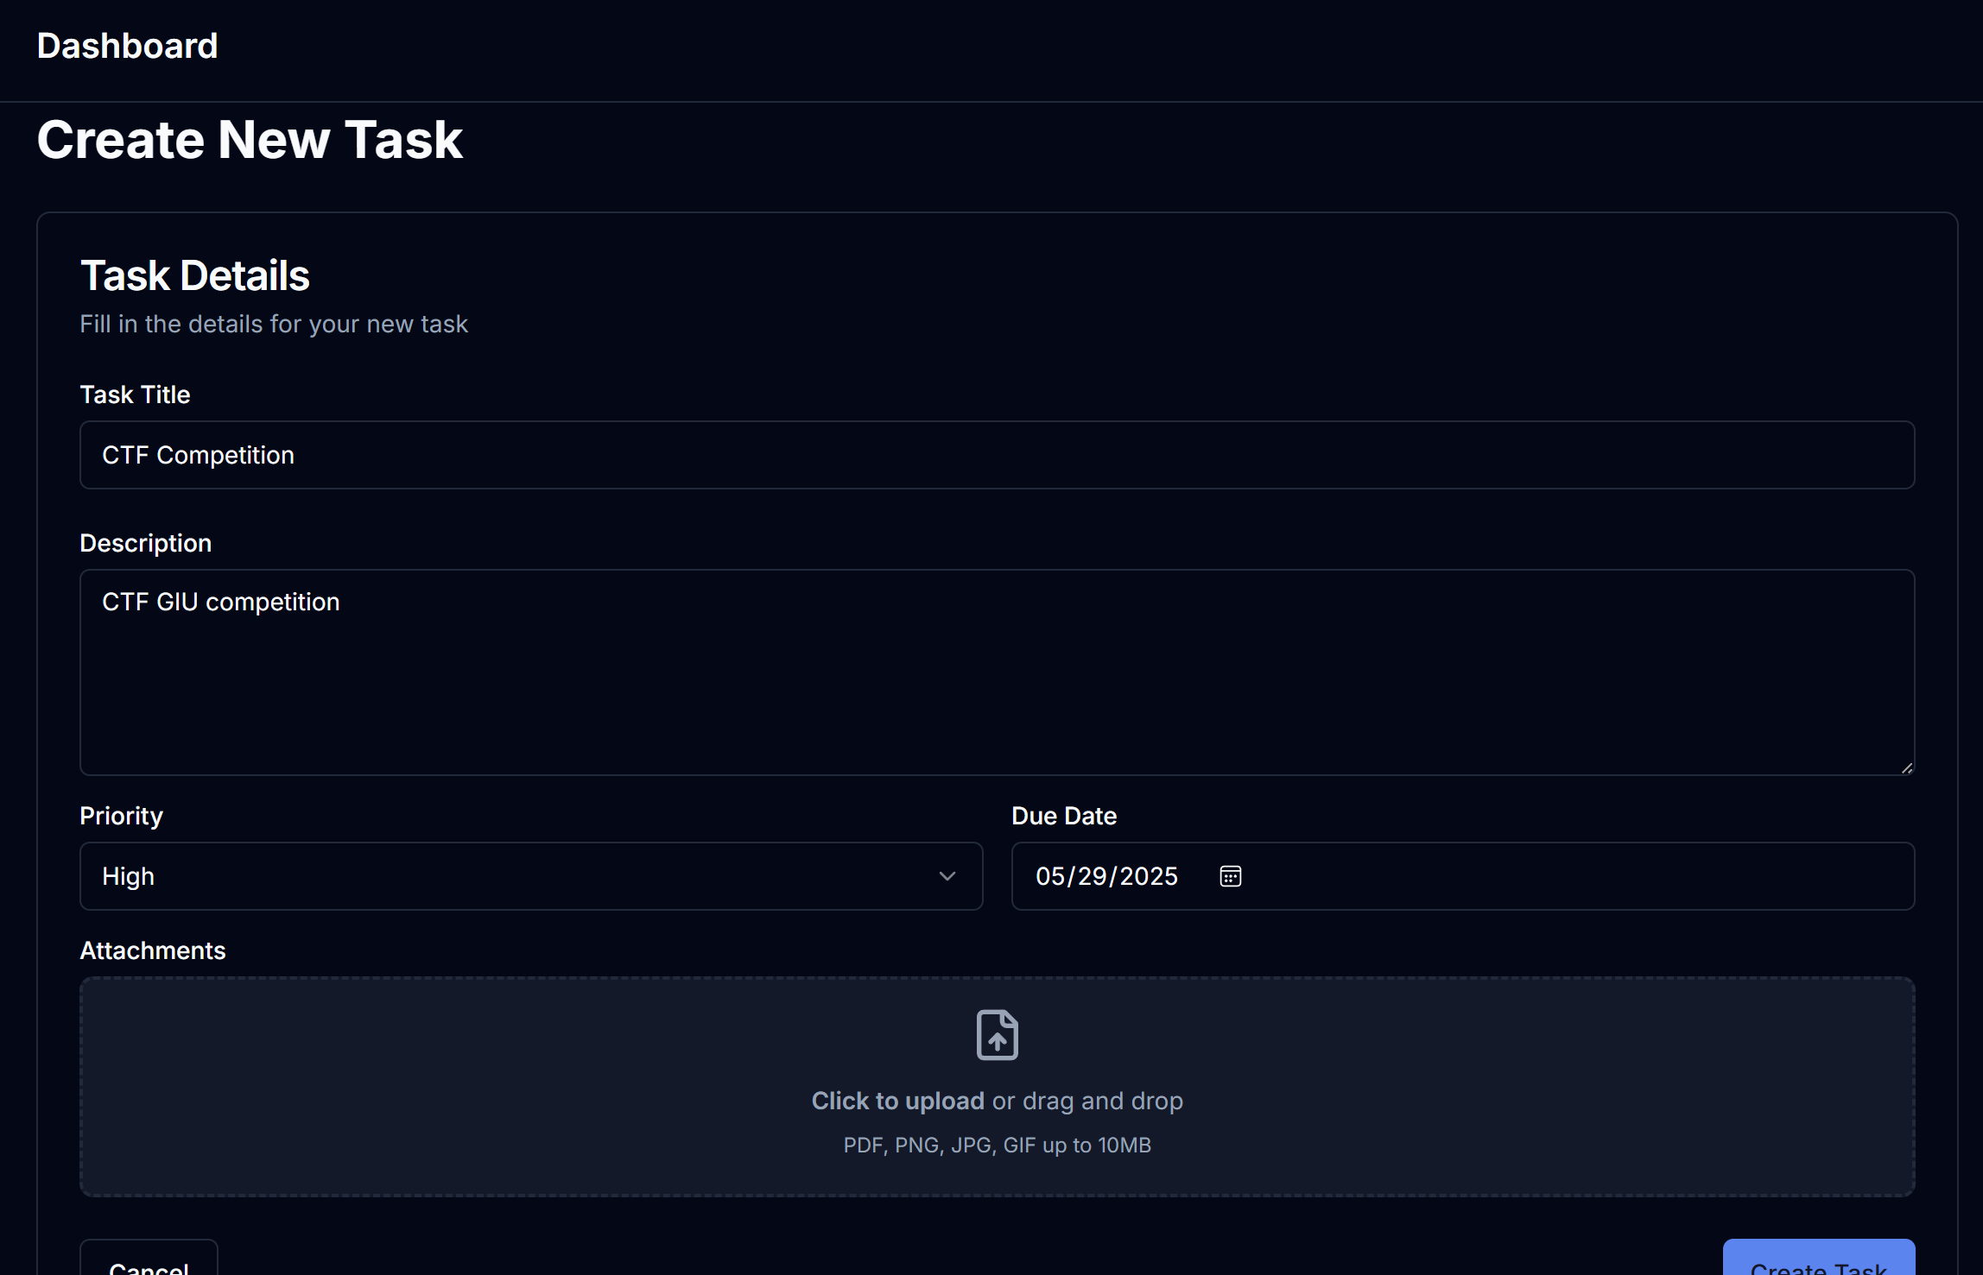
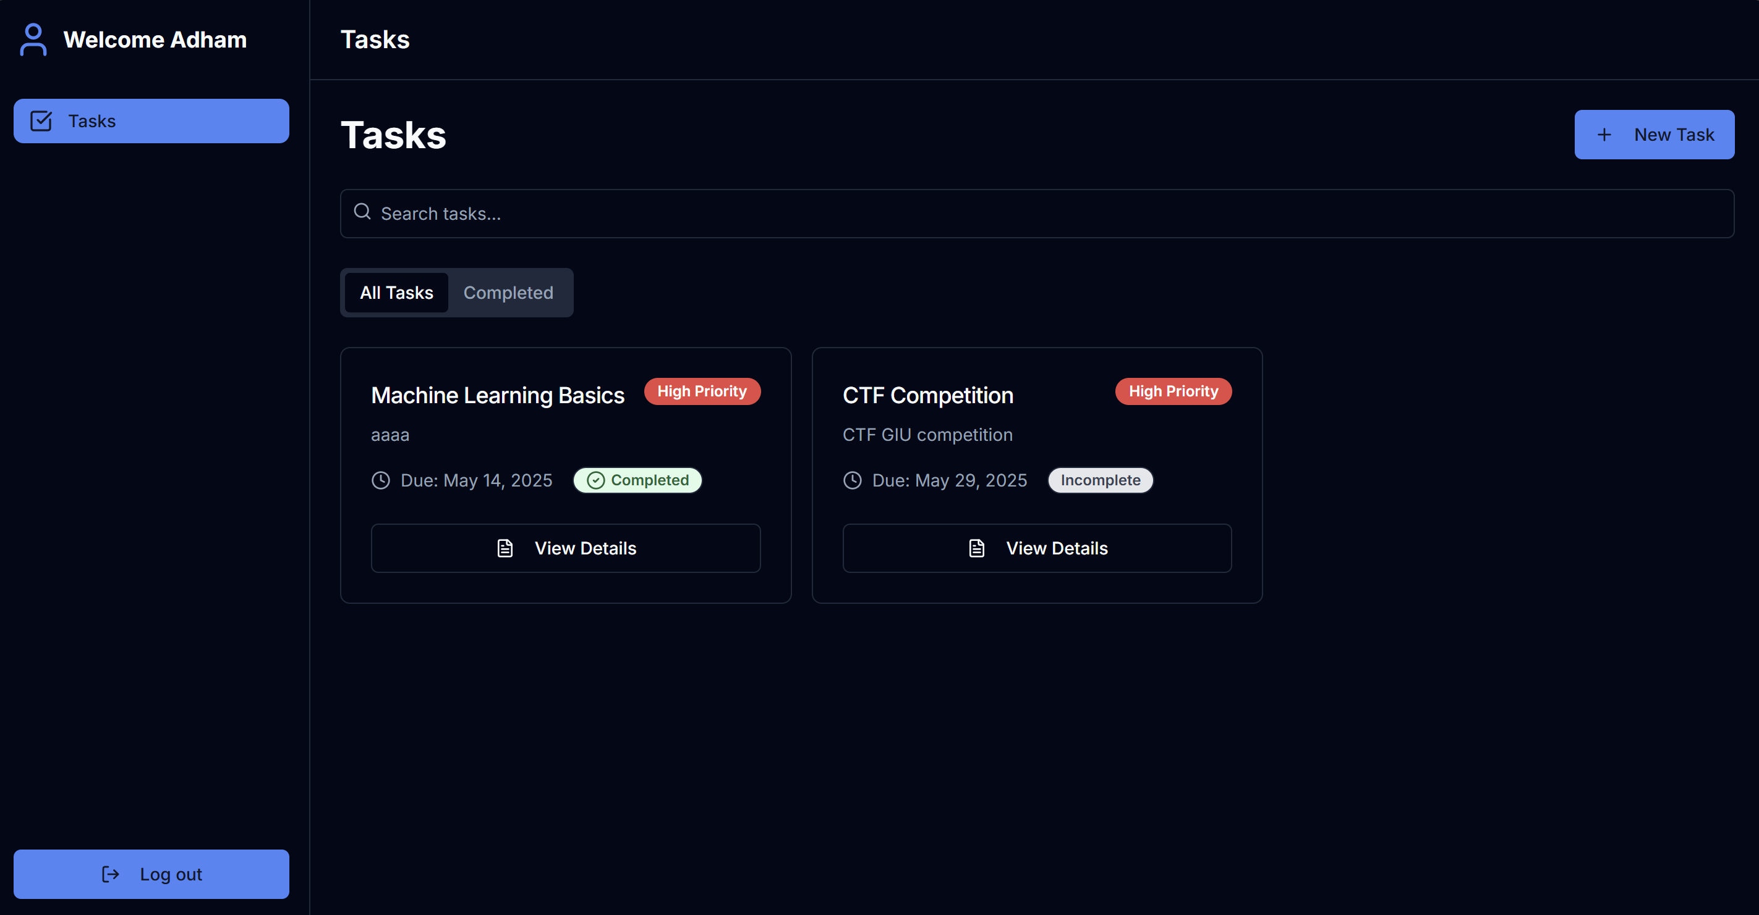

Slide 12
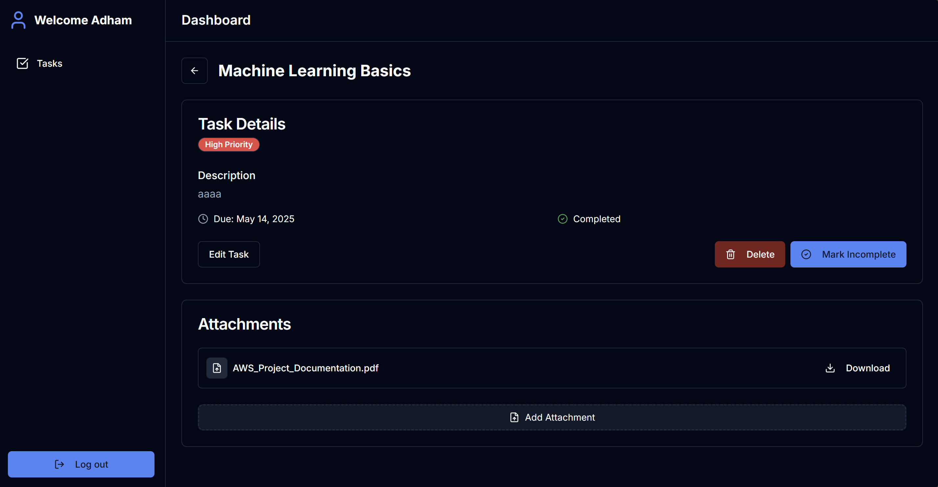
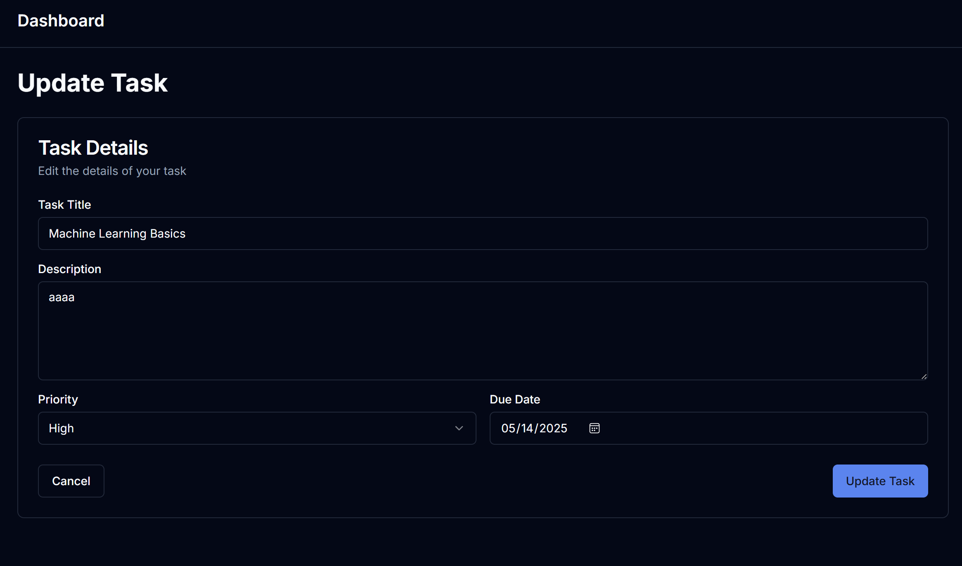

Slide 13
Conclusion
Project Success: We successfully built a Task Management System using AWS services and Next.js, integrating task creation, updates, file management, and notifications.
Learning: Gained hands-on experience with AWS CDK, serverless architecture, and various AWS services like Lambda, Cognito, S3, and DynamoDB.
Next Steps: Future improvements include adding analytics, scalability, and enhanced security features.
Thanks: Thanks to our team and mentors for their support throughout the project.

Slide 14
Thank you!
Do you have any questions?

